Slide 1
Capstone Project Presentation
AI Chatbot for Kisan Call Centre
Aslam Pasha
Divya Abraham
Swagatika Samal
Vishnu Bansal

Slide 2
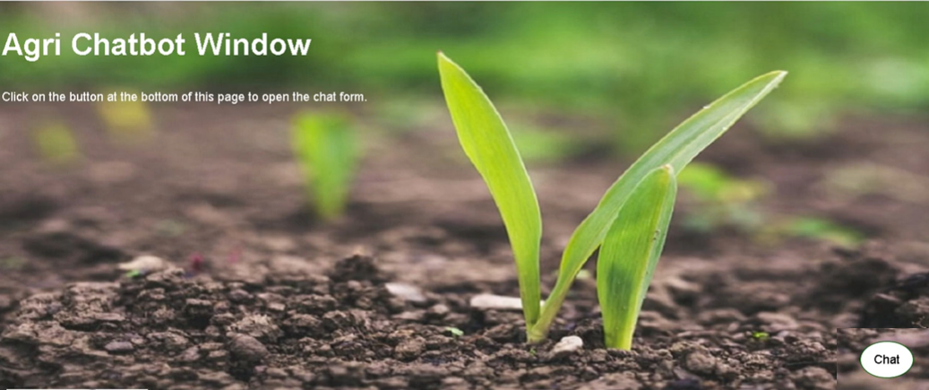
Problem statement
Why a Chatbot on Agriculture?
~31 percent of Indian workforce worked in Agriculture which contribute around 15.4 percent of Indian GDP
People working in this industries is not highly educated and may not have proper guidance
Farmers are looking for help from Government and they are able to provide during working hours
AI based Chatbot is addressing this problem and will be available 24*7 to provide help.

Slide 3
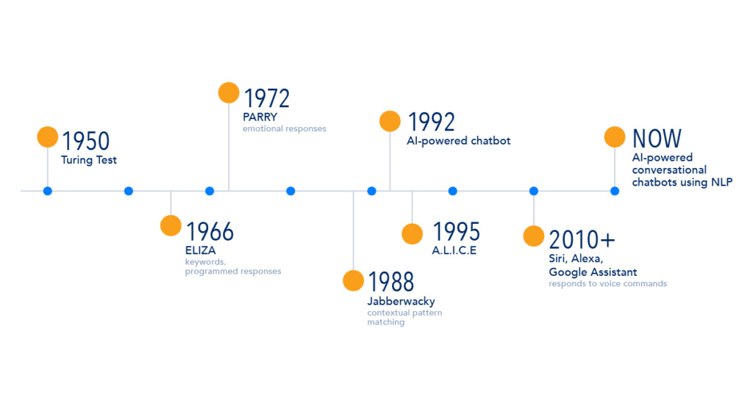
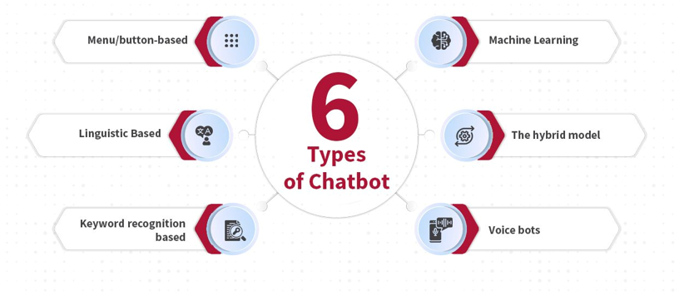
Literature Survey
Evolution of chatbots
Types of Chatbots

Slide 4
Literature Survey
Pattern Recognition : Pattern recognition is a data analysis method that uses machine learning algorithms to automatically recognize patterns and regularities in data. This data can be anything from text and images to sounds or other definable qualities. Pattern recognition systems can recognize familiar patterns quickly and accurately.
Canned Responses : Canned responses are quick replies that you can create and save in your customer support tools such as live chat or email. Once a customer asks a routine question, you can pick the answer and send it to them, without typing.
Encoder Decoder : It predicts a word given in the user input and then each of the next words is predicted using the probability of likelihood of that word to occur. In building our Generative chatbot we will use this approach for text generation given in the user input.
Turing Test : The Turing Test is a method of inquiry in artificial intelligence (AI) for determining whether or not a computer is capable of thinking like a human being.

Slide 5
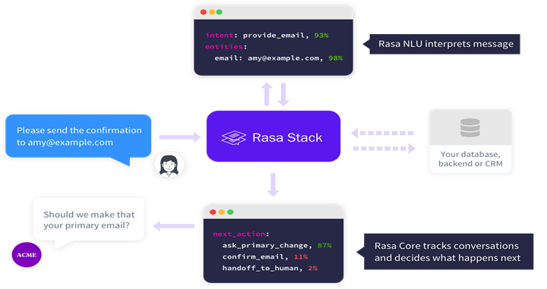
Rasa Architecture
Rasa is an open source chatbot framework which has two main components:
• Rasa NLU (Natural Language Understanding): Rasa NLU is natural language processing tool for intent classification and entity extraction which helps the chatbot to understand the user input.
• Rasa Core: Machine learning-based dialogue management which takes the structured input from the NLU and predicts the next best action using a probabilistic model using LSTM or Neural Network. it also uses reinforcement learning to improve the prediction of the next best action

Slide 6
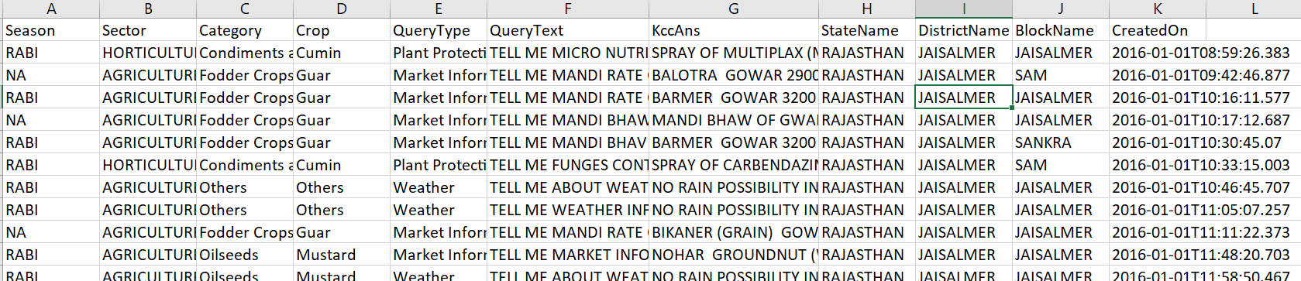
Kisan call centre Dataset
Kisan call center dataset collected from Govt website for Rajasthan Jan 2016
Row data was in json format which was cleaned and converted to csv format
Data consist of majority of calls related to the following from Kisan call center
Query Type | Query %
Plant Protection | 12.33
Weather | 22.73
Market Information | 11.5
Fertilizer Use and Availability | 11.79
Soil testing | 6.78
Nutrient Management | 14.67
Others | 20.2

Slide 7
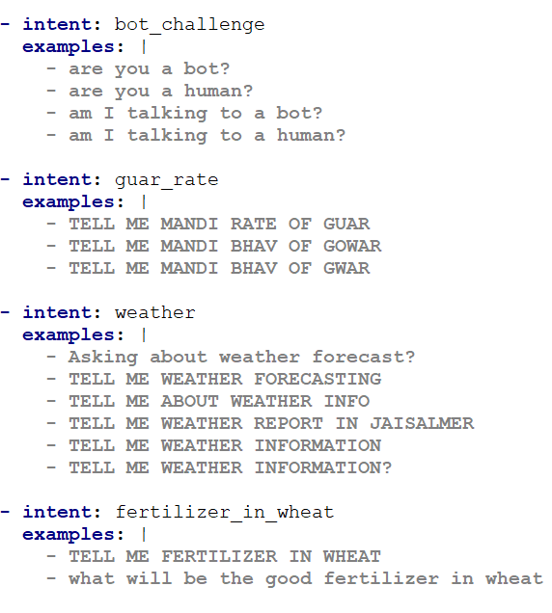
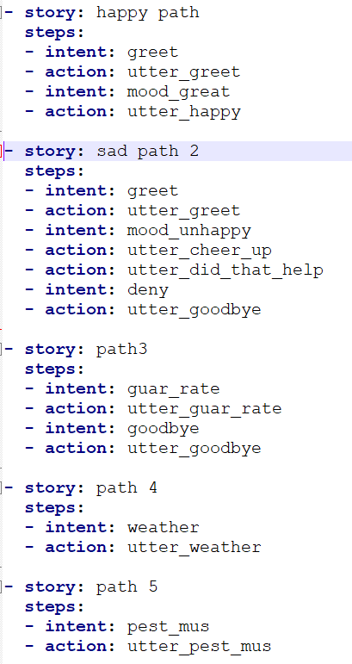
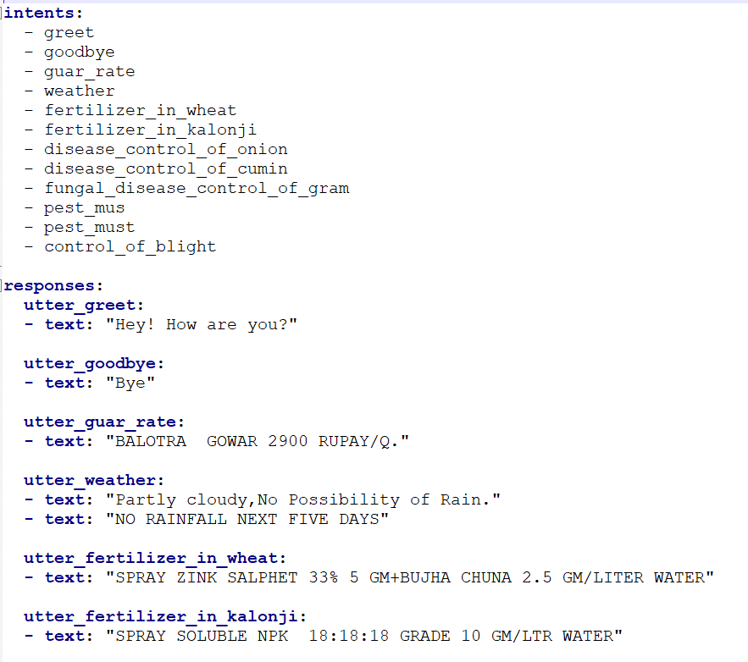
Training dataset Preparation
Identified the intent and entity from the query
nlu.yml file has all the intent and corresponding query text
story.yml file has all the systematic way of conversation including intent and actions
domain.yml file has intent, action, response and query answer

Slide 8
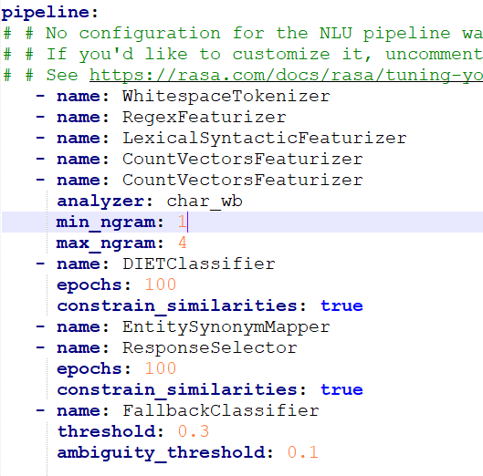
Train the Model
Model pipeline design to perform the activity in sequence
Language model component: Agri Chatbot used a LanguageModelFeaturizer to support English language.
Tokenizer component: Tokenizer components are closely related to languages. No tokenizer can support all languages. You should choose the appropriate tokenizer according to your language. WhitespaceTokenizer can be used for space-splitable languages.
Featurizer component: This extracts features from token sequences using RegexFeaturizer. There can be multiple feature extraction components to generate different features.
Entity extractor component: DIETClassifier performs named entity extraction on the text using the features provided by the previous components
Intent classifier component: DIETClassifier classifies text into different user intents according to context
Structure output: This organizes the prediction results into structured data and outputs it. This part is not a component but a built-in function within the pipeline. Developers are not able to directly access it as a component.

Slide 9
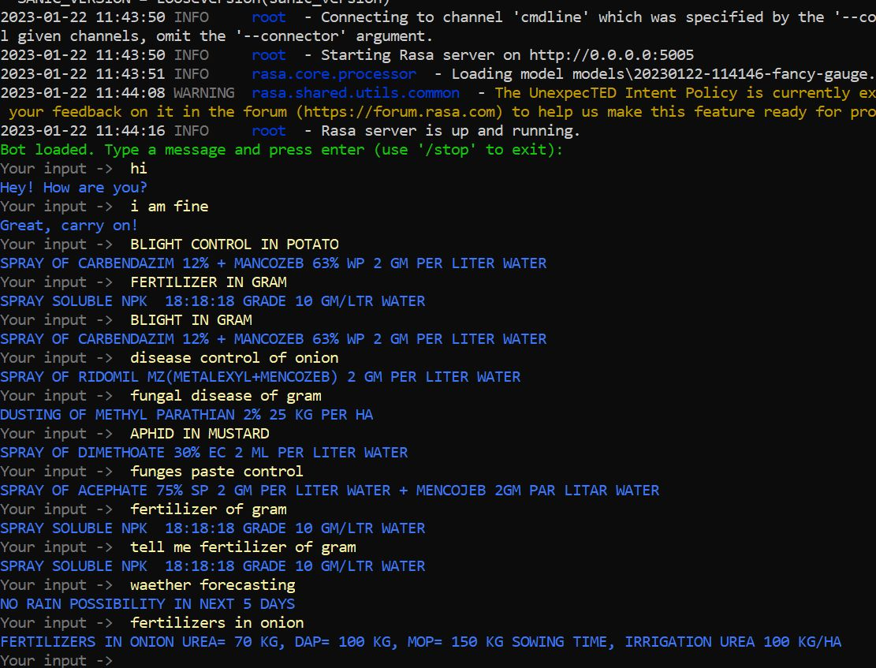
Results
We have tested the built model and found it to be satisfactory in providing a relevant response.
AGRI Chatbot was able to successfully converse with the user.
It Identified the intent and entity for which it was trained.

Slide 10
Demo

Slide 11
Future Scope
Agri chatbot is the basic working model built top of Rasa framework. This will be enhance to build below functionality
Virtual conversational Chatbot: Based on study, Formers are not highly educated in India and they prefer verbal communicate in local language. Bot should support voice & text based conversation in multiple language
ChatbotGPT: Chat GPT is defined as a generative language model developed by OpenAI This is a latest innovation to analyzing the quantitative and qualitative data in many ways to make interaction like human being.
Rasa with BERT Model: Bidirectional Encoder Representations from Transformers, is a deep learning model in which every output element is connected to every input element. General language model read text sequentially but BERT read data bidirectionality.

Slide 12
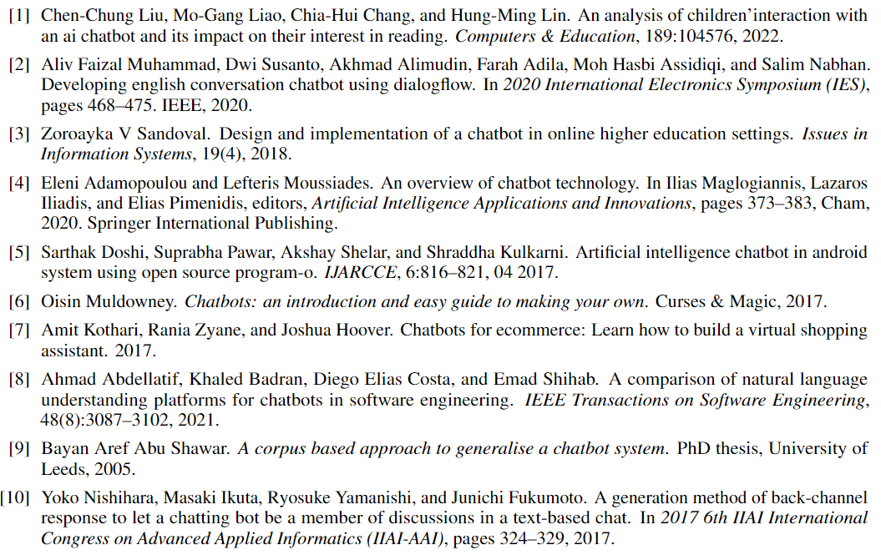
References

Slide 13
Thank you

